Slide 1
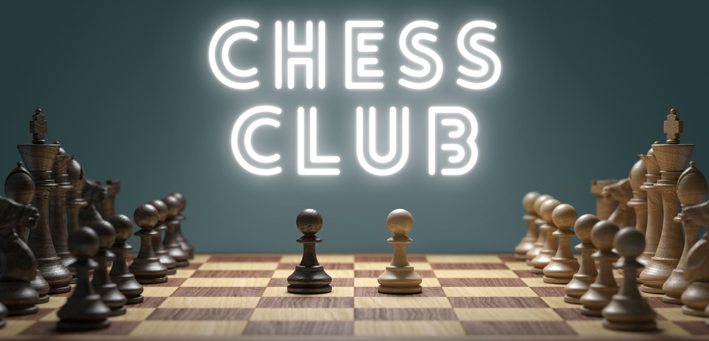


Slide 2
Hello, World!
Name
Grade
Do you know to play Chess?
Notes:
Welcome (5 min) Code Senseis introduce themselves
Review logistics and important information like where to put personal belongings, daily routines, bathroom etc.

Slide 3

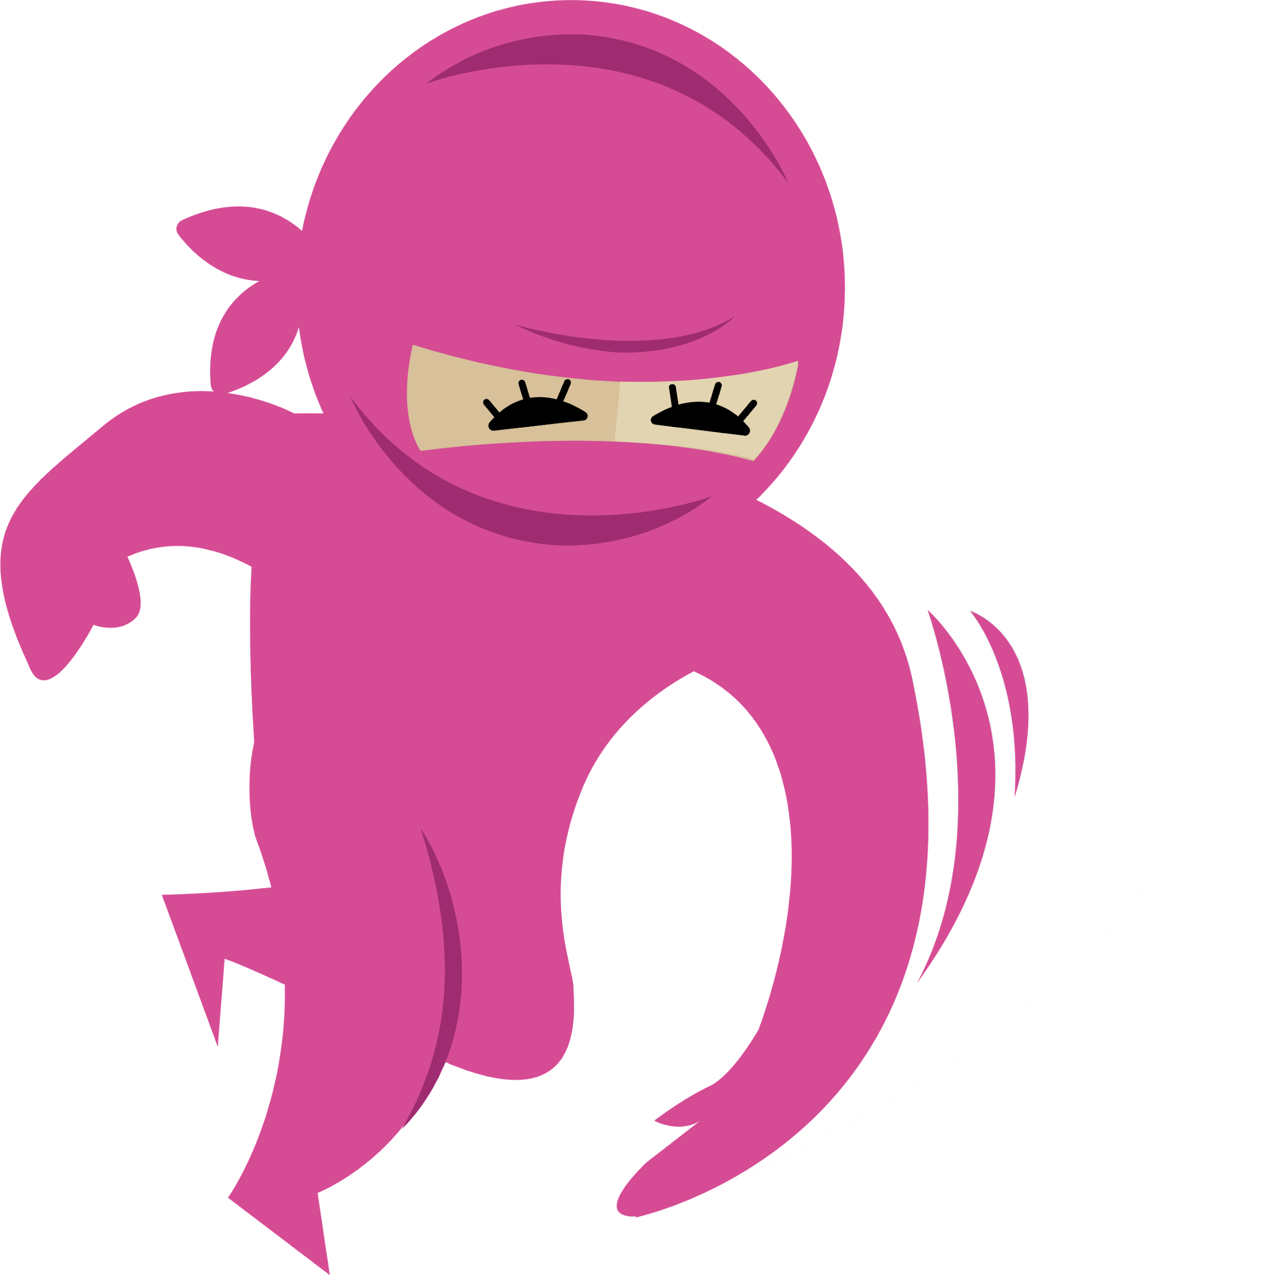

Expectations
Remember to ask your sensei questions!!!
Always be respectful of others
Have fun!
Respect our technology
Trust the learning process
Notes:
Go through the rules and expectations of camp behavior in the dojo: Always be respectful of others. Have fun. Respect our technology. Trust the learning process.

Slide 4
CLUB GOALS
#1 Goal: To have FUN
#2 Goal: Learn the fundamentals of chess
#3 Goal: Learn some awesome strategies to help you beat your parents!
#4 Goal: Improve critical thinking and problem-solving skills.

Slide 5
Week 1: Welcome to Chess Club
Today we will...
learn how to set up the board and their coordinates
investigate all the chess pieces and what they do

Slide 6
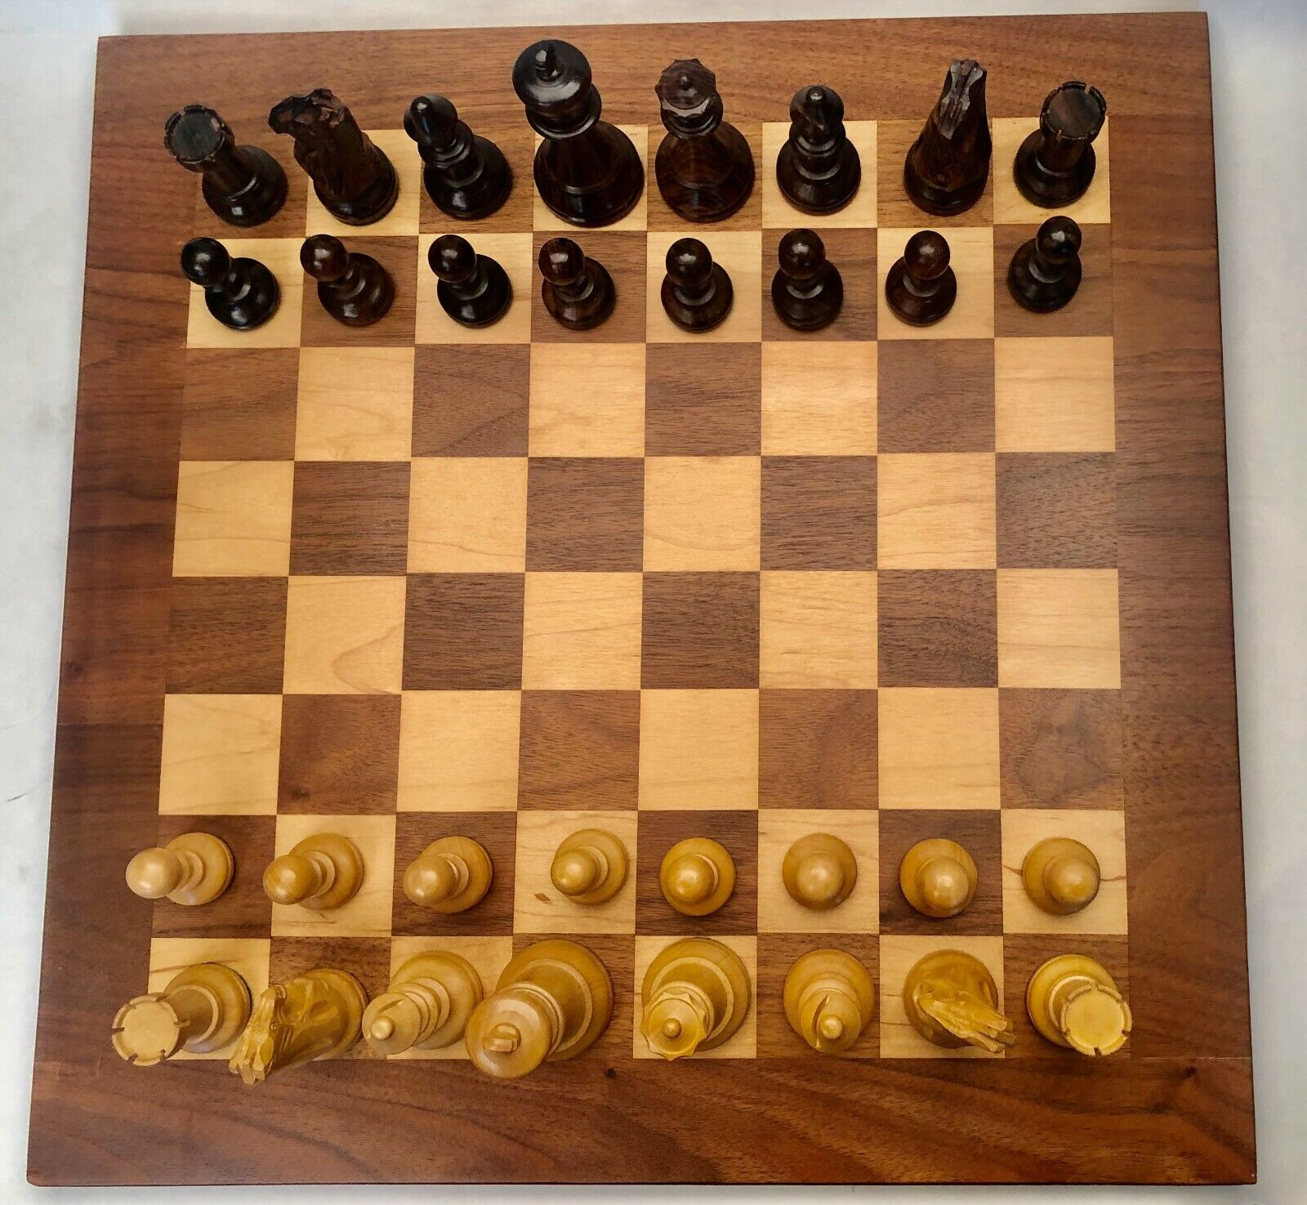
The Board
8x Pawns
2x Rooks
2x Knights (Horse)
2x Bishops
1x Queen
1x King

Slide 7
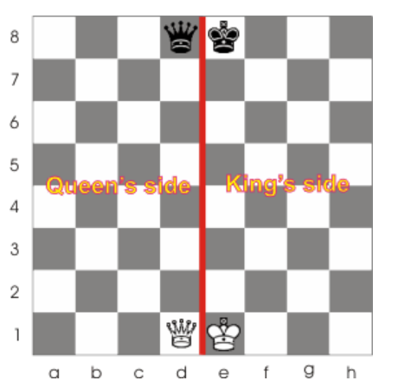
Placing the King and the Queen

Slide 8
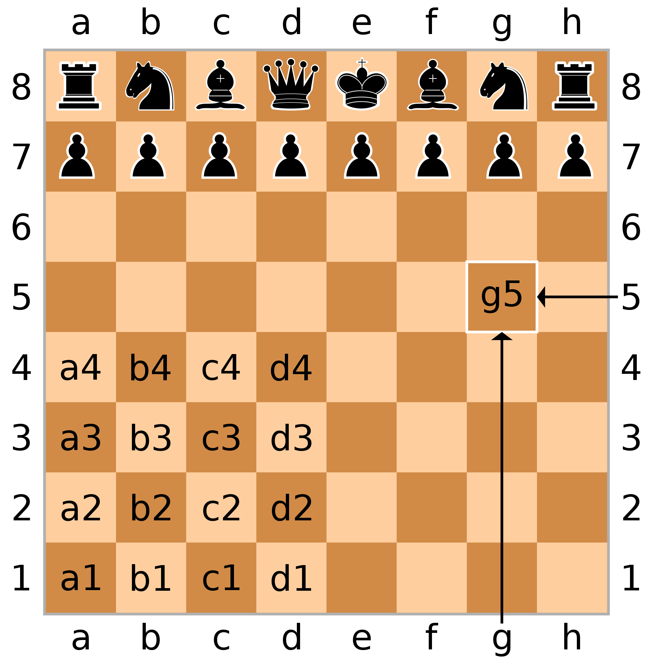
The chess board using algebraic notation
Columns are identified lettering a - h
Rows are identified numbering 1-8
White left to right is:
a1, b1, c1, d1, e1, f1, g1, h1
Black left to right is:
h8, g8, f8, e8, d8, c8, b8, a8
Can you see a pattern?

Slide 9
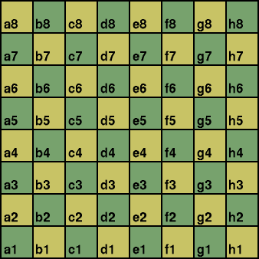

Slide 10
Let’s Introduce the Pieces

Slide 11
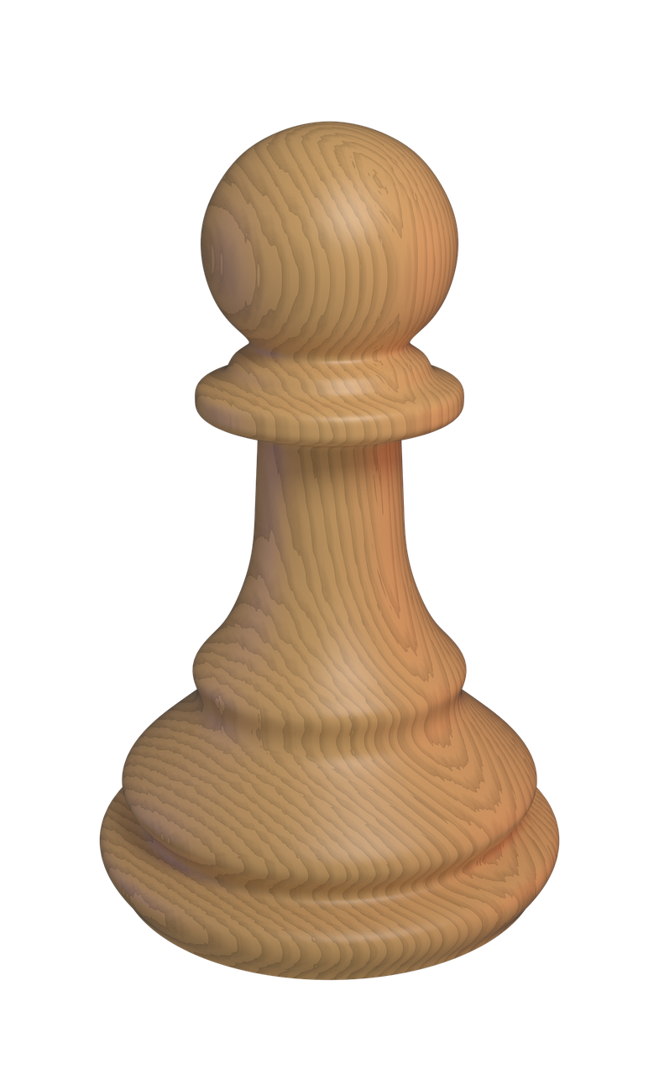
Pawns
Movements
They move one square forward and cannot move backwards.
If they start at the second row, they can move one or two squares forward.
Capture
To capture with a pawn,
you have to move one square diagonally

Slide 12
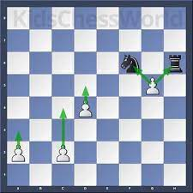
Examples of a pawns move set
Cannot move backwards
Can only capture diagonally
Can only move 1 space forward
If in starting position can either move 1 space or 2 spaces forward

Slide 13
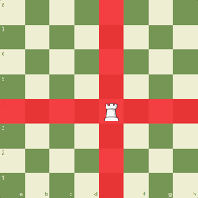
Rooks
Rooks can move any number of squares Up, Down, Left, or Right but NOT diagonally.
Rooks move and capture the same.

Slide 14
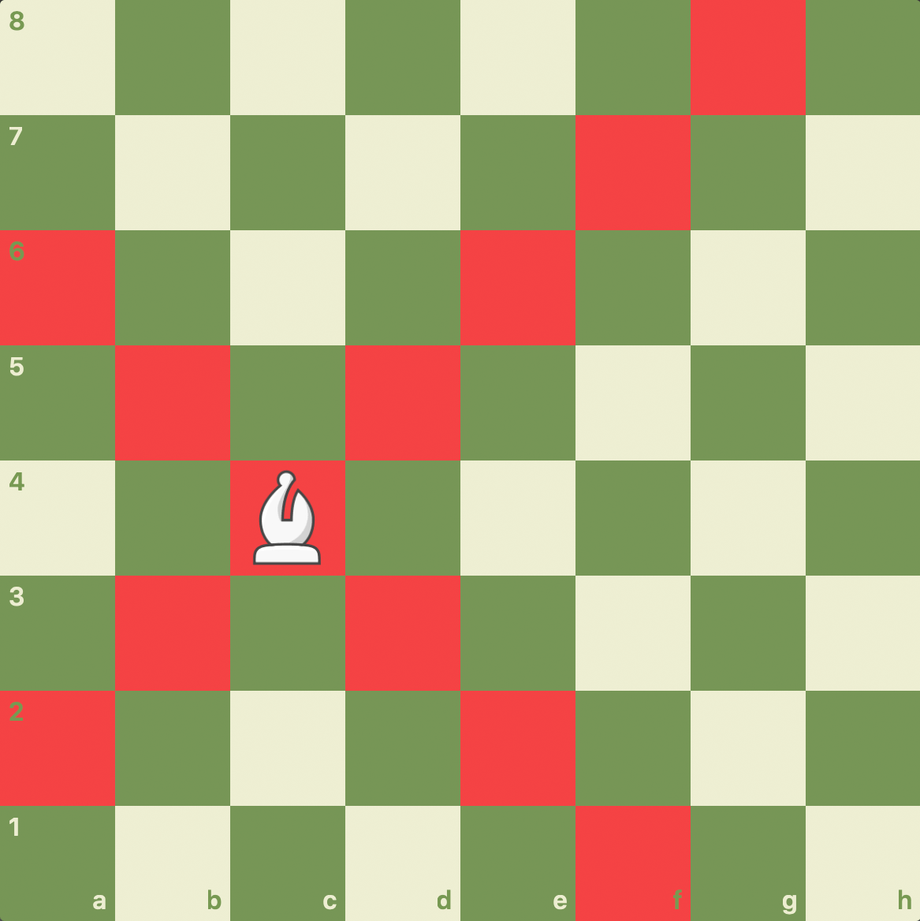
Bishops
Bishops can move any number of squares diagonally.
Bishops also move and capture the same.

Slide 15
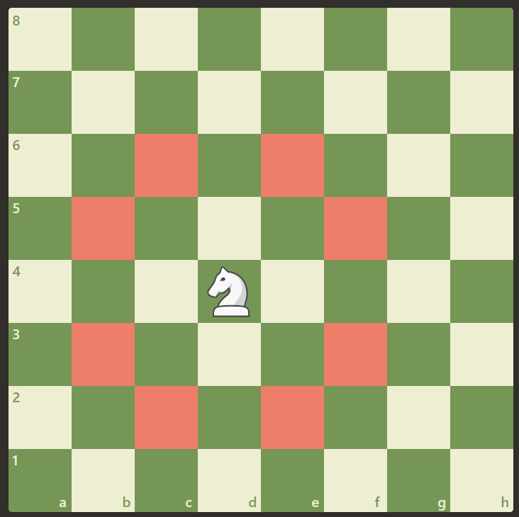
Knights (Horses)
Knights move in a weird way
Knights move in an L pattern
The Knight is the only piece that can jump over other pieces!

Slide 16
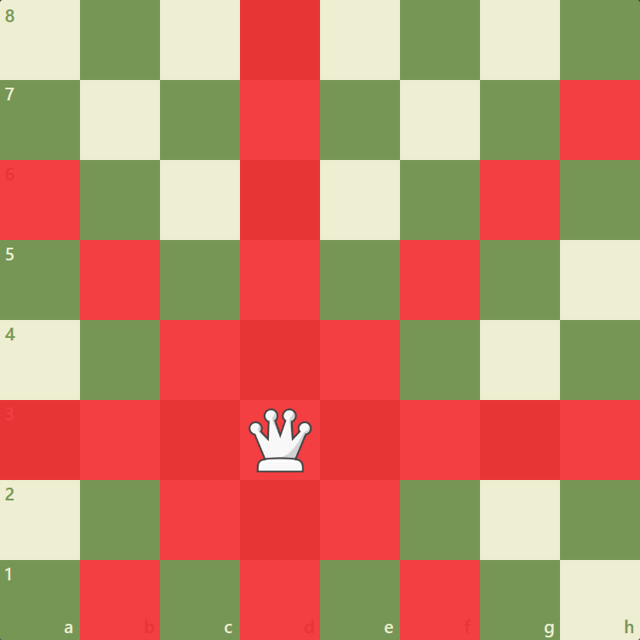
The Queen
The Queen is a combination of both the Rook & the Bishop!
This means she can move either diagonally, up/down, or left/right.
She is your most powerful piece!

Slide 17
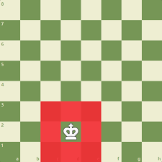
The King
The King can move one square in any direction.
Protect your King at all costs!!!

Slide 18
Review Time
Now it’s time to set up the chess board yourself.
See if you can do it from memory

Slide 19
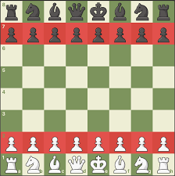

Slide 20
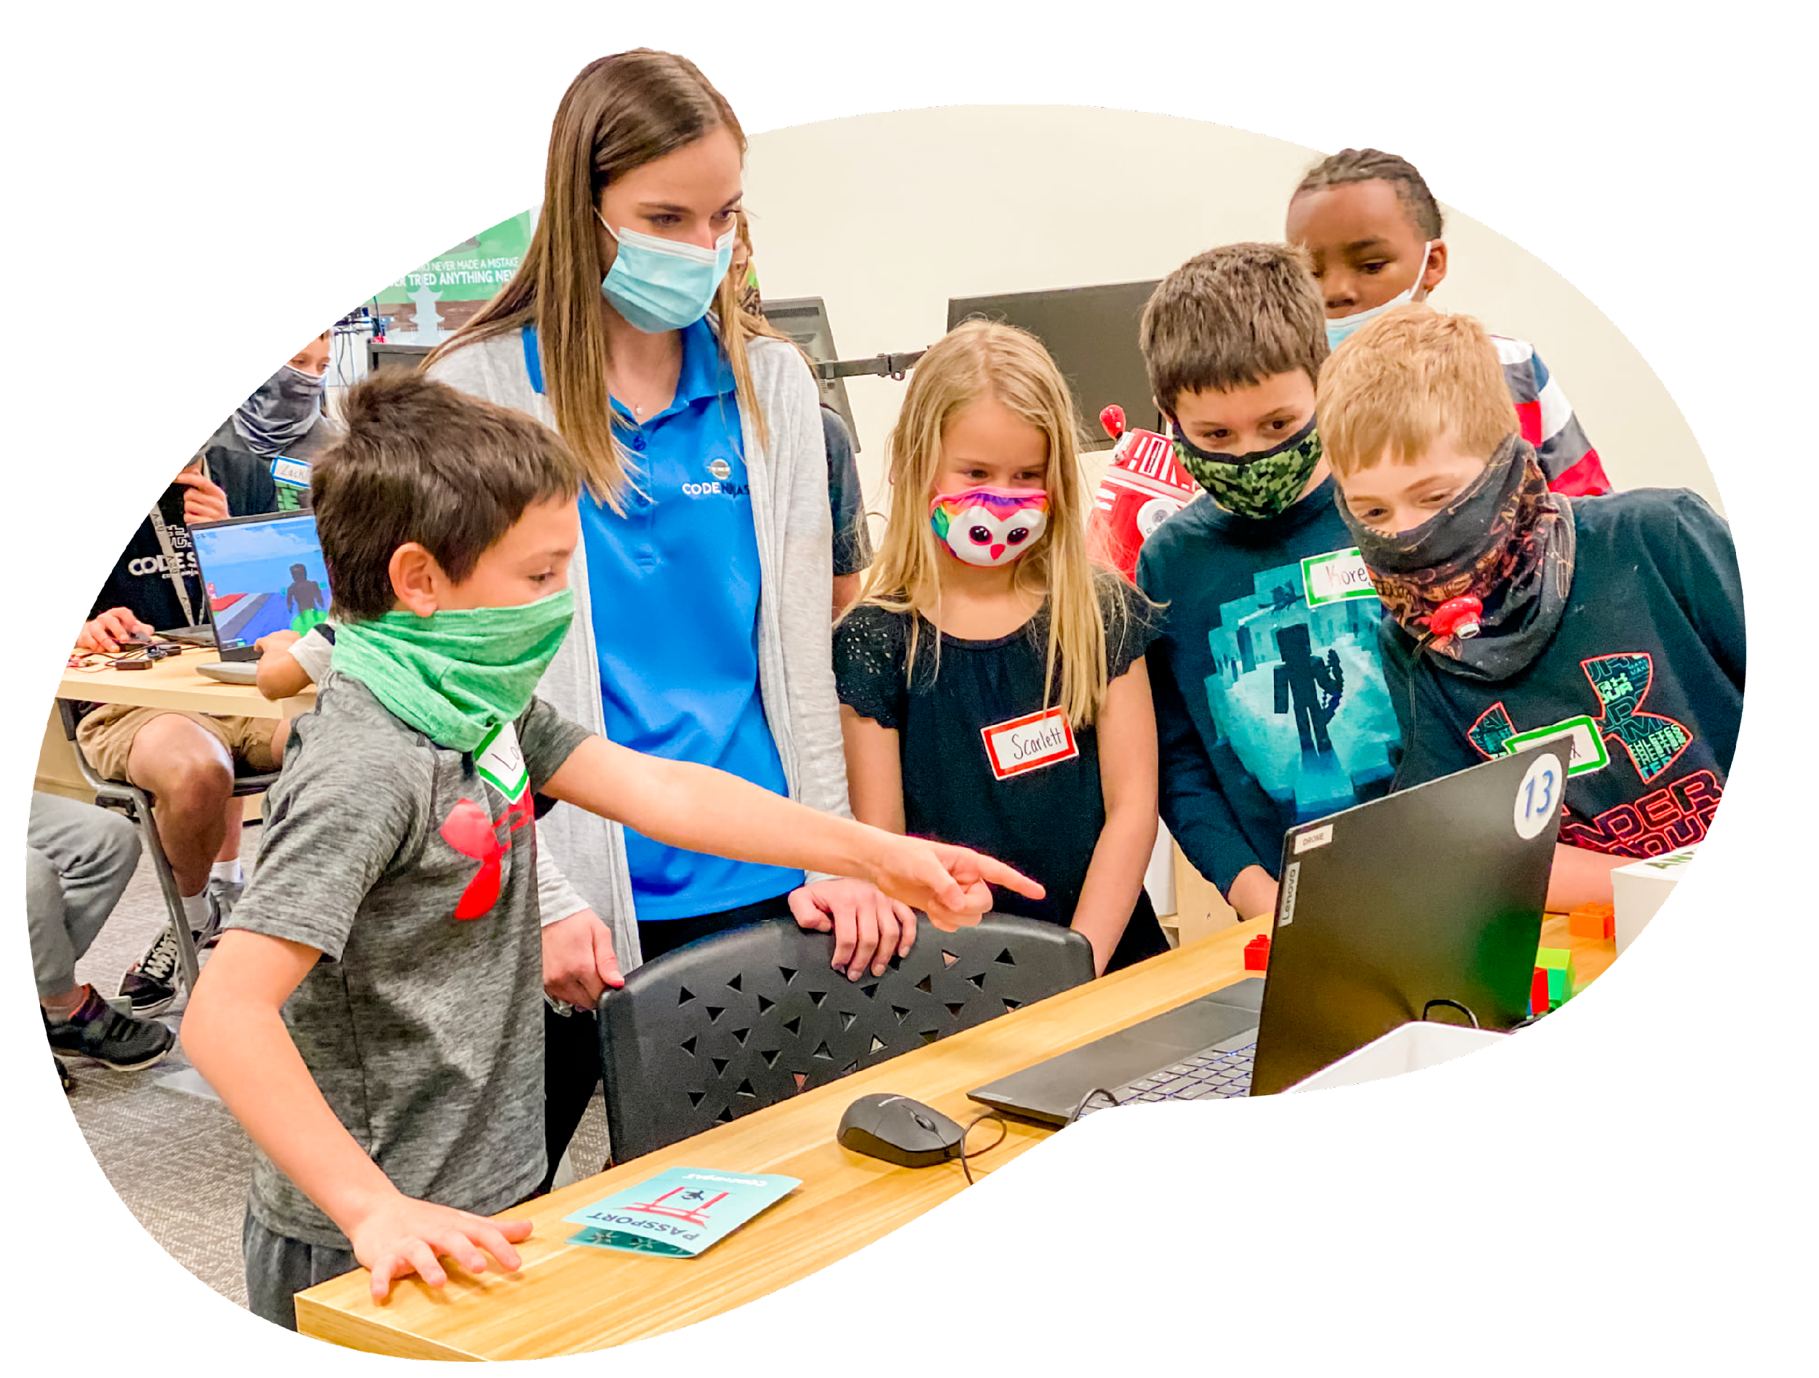
CLOSING CIRCLE
Share:
“What did you enjoy most today?”
“What is still confusing or unclear?”
Ninja Shout Outs:
“How did someone help you today?”
Notes:
CLOSING CIRCLE (10 min) Everyone should pitch in to clean and organize the center.
Gather ninjas in a circle, preferably away from the computer work area. Make sure that the conversation is inclusive, and many ninjas have a chance to share.

Slide 21
Week 2:
Today we will...
learn strategies involving pawns and bishops
practice using pawns and bishops on the board

Slide 22
Pawn Strategies
Pawns like to be promoted on the other side of the board.
When the pawn reaches to the other side, it can promote to either a queen, rook, knight, or bishop.
So, one path to victory using pawns is the player to get the most pawns promoted at the other side of the board.

Slide 23
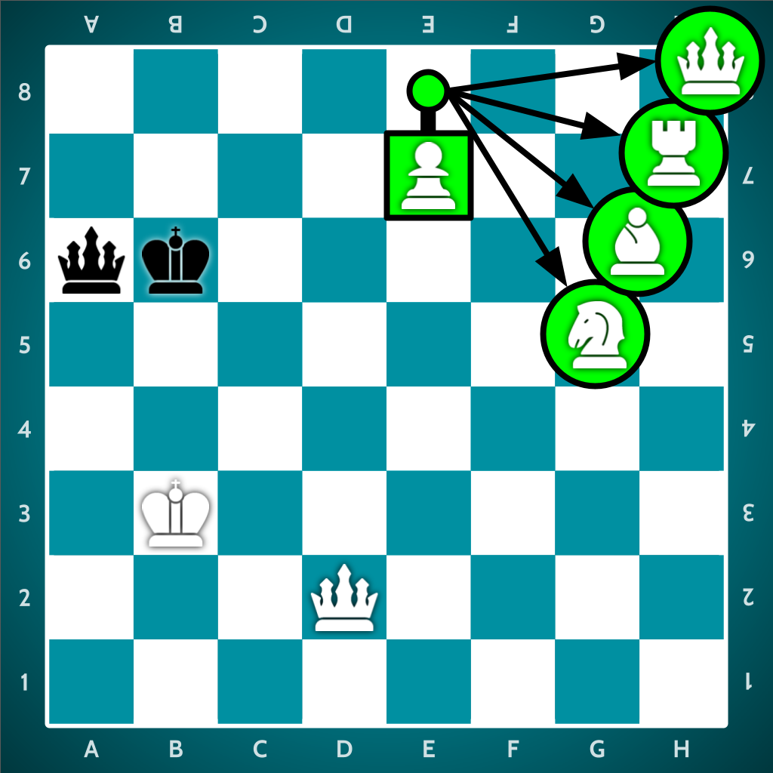

Slide 24
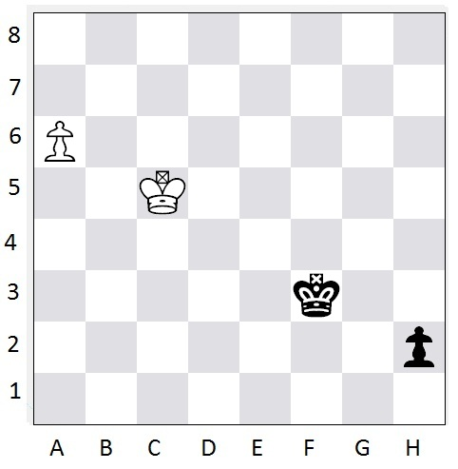
The Pawn Race
Both white and black are trying to promote their pawn to a queen.
Which pawn will promote first?

Slide 25
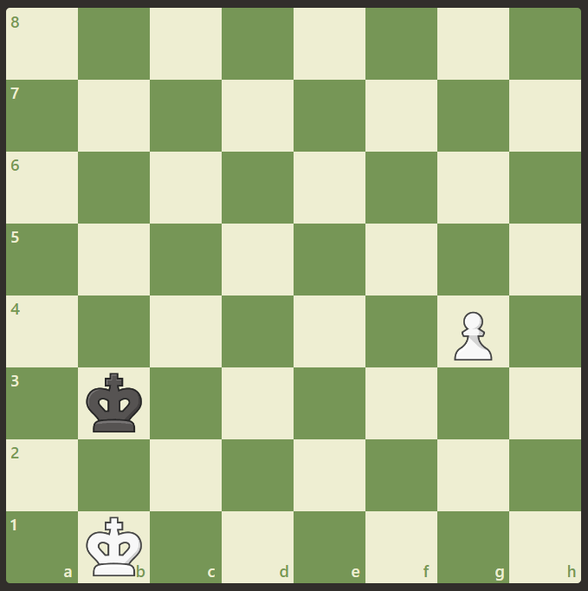
Can White Promote Safely Here?

Slide 26
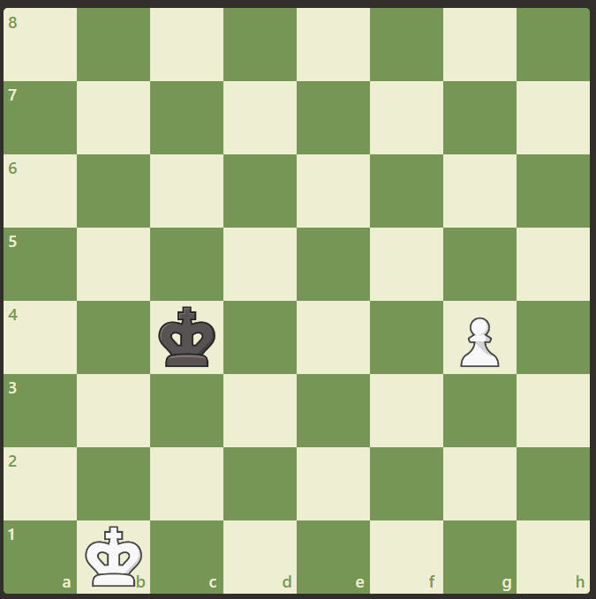
Can White Promote Safely Here?

Slide 27
One Square Can Really Make the Difference!

Slide 28
So, how do we quickly determine if the pawn can promote safely in time?

Slide 29
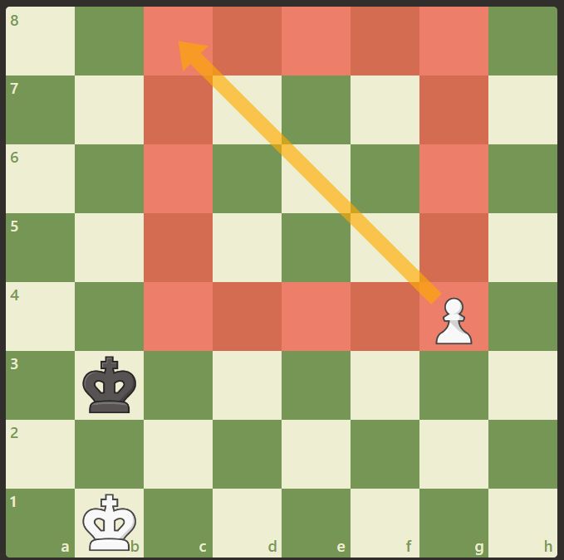
The trick is to draw a diagonal line and create a box towards the direction of the king like in this picture.
If the king is outside of this box, the pawn will safely promote before the king is able to capture the pawn.

Slide 30
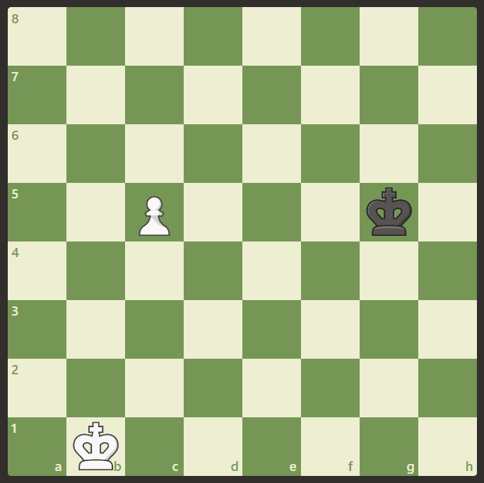
It’s White’s turn! Can White promote safely?

Slide 31
What if it’s Black’s turn?

Slide 32
Bishop Strategies
Bishops like to take control of open diagonals
Each player has a bishop that moves only on dark squares and a bishop that moves only on light squares
So, with pawns and bishops on the board, you want to push pawns so that you can open diagonals for your bishops.

Slide 33
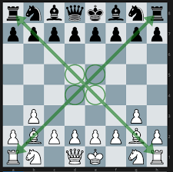
Note: The best position for a bishop is one where it commands an open diagonal, and cannot be attacked by enemy pawns or knights.

Slide 34
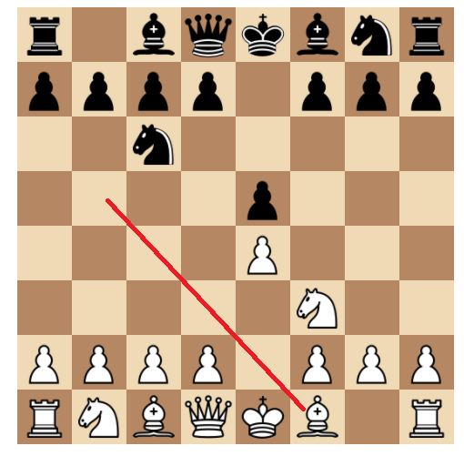
Use Pawns to Open Bishops
e4-pawn is a popular move because it takes control of the middle and opens up your light-square bishop
d4-pawn is the next best move as it takes control of the middle and opens up your dark-square bishop

Slide 35
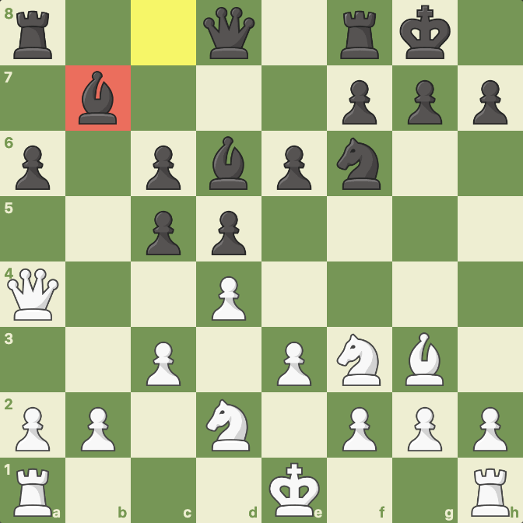
Bad Bishop
Bishops are bad when they have no access to open squares in their diagonals and are blocked by their own pieces.

Slide 36
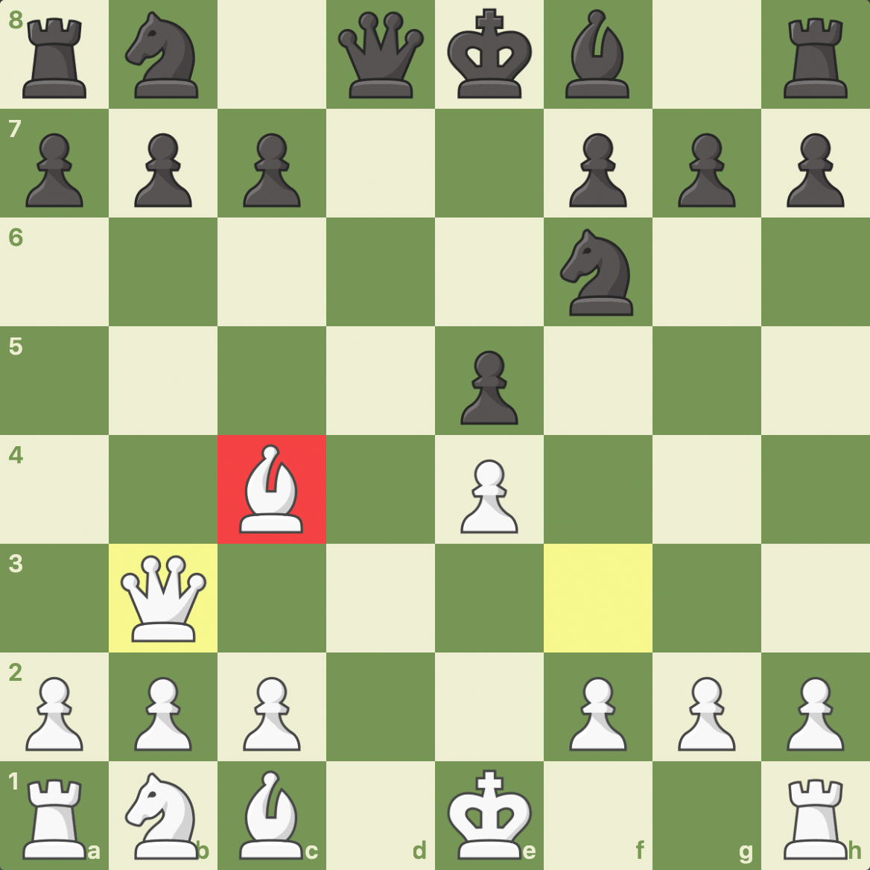
Good Bishop
Bishops are good when they are not blocked by their own pieces and have more freedom to move in their diagonals.

Slide 37
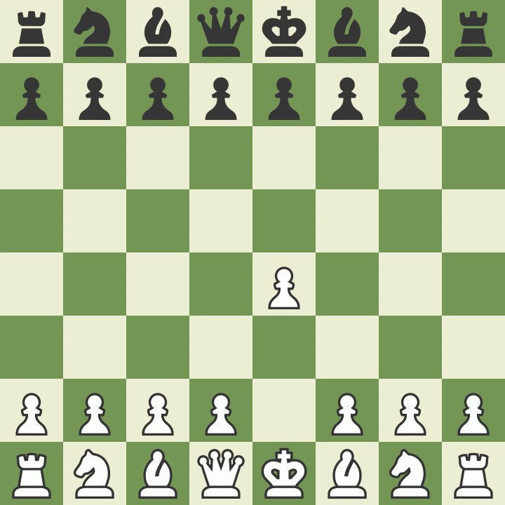
Bishop Opening Full Strategy
Pros:
Less common
Solid
Does not block the f2-pawn
Cons:
Does not put immediate pressure on Black
The bishop could come under attack by d5-pawn

Slide 38
Review Time
Now it’s time to practice our pawn and bishop strategies on the chess board.
Remember how pawns and bishops move.

Slide 39
CLOSING CIRCLE
Share:
“What did you enjoy most today?”
“What is still confusing or unclear?”
Ninja Shout Outs:
“How did someone help you today?”
Notes:
CLOSING CIRCLE (10 min) Everyone should pitch in to clean and organize the center.
Gather ninjas in a circle, preferably away from the computer work area. Make sure that the conversation is inclusive, and many ninjas have a chance to share.

Slide 40
Week 3:
Today we will...
learn how to use the king and queen together
discuss what is checkmate and stalemate
learn how to checkmate with a queen and king vs king
discuss Scholar’s Mate (4 move checkmate)

Slide 41
Checkmate vs Stalemate
A checkmate in chess is a game-ending state in which one player's king is threatened, and the player cannot move their king out of danger or take the threatening piece.
When a player successfully puts their opponent in checkmate, they win the game.
Just like with Checkmate, in a Stalemate the King cannot move—he has no Safe Squares
In fact, a Stalemate happens when there are no legal moves, just like Checkmate
The only difference is that since the King isn't threatened, the attacker can't claim a win and the game is declared a Draw!

Slide 42
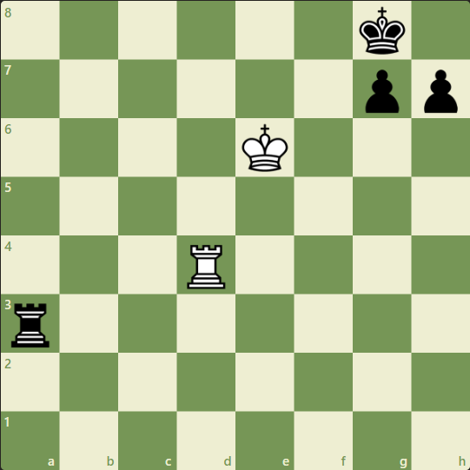
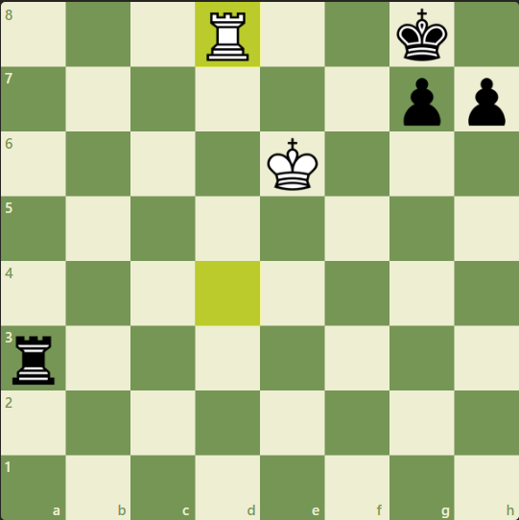
Checkmate
Why is this checkmate?
d8-rook blocks all of row 8 and white king blocks the f7 square making every move threatening to the king!
Its whites move, can you find the checkmate?

Slide 43
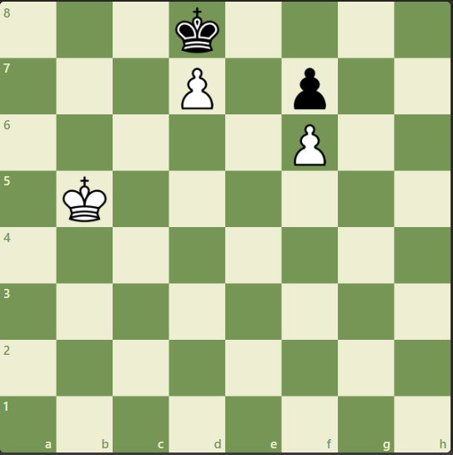
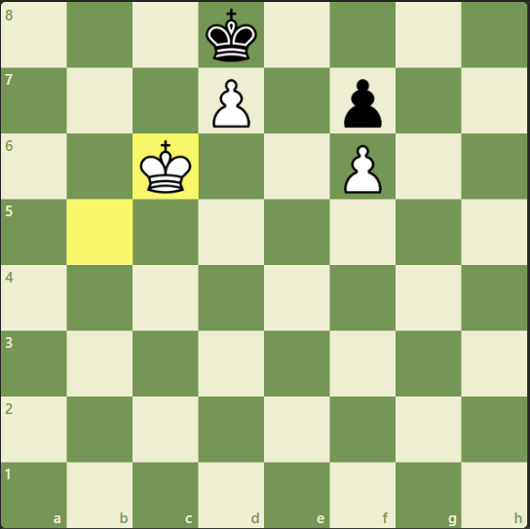
Stalemate
Why is this Stalemate?
d7-pawn blocks c8 & e8 and moving the white king to c6 prevents the d7-pawn from being captured
Its whites move, can you find the stalemate?

Slide 44

Checkmate using king and queen
Knowing how to checkmate with a king and queen versus a king is a very common checkmate that is extremely valuable to know!
We learn a method that some call the "boxing" or "rectangle" method.
This method has 4 steps, let’s check them out.

Slide 45
King & Queen Boxing Method
Putting the opponent's king in a box by moving our queen a knight-move away
Decreasing the size of the box by "dancing with the king,"
"Freezing the queen" after the king is in a corner, and
Walking our king over to deliver checkmate!

Slide 46
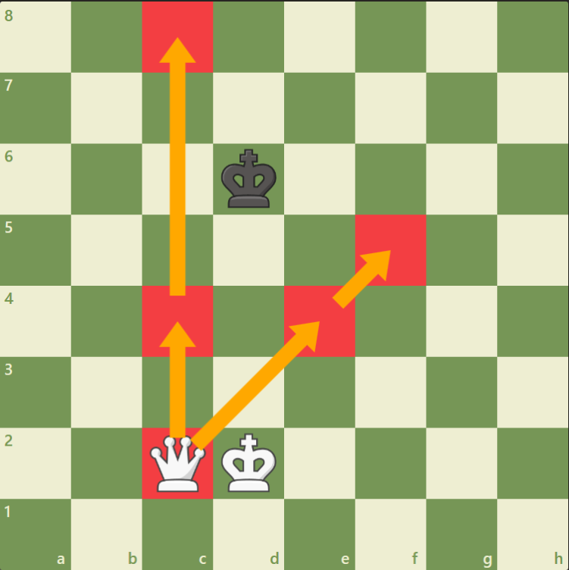
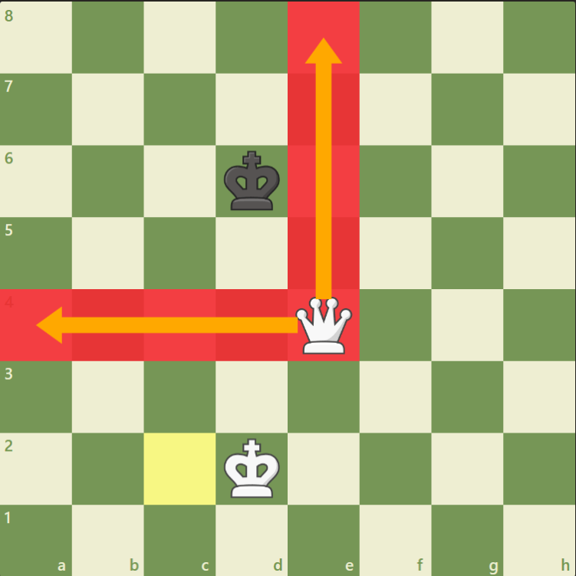
Putting the opponent's king in a box
We can put the opponent's king in a box by simply moving our queen a knight-move away.
Now that we have the enemy king in a box, we can start "dancing with the king."

Slide 47
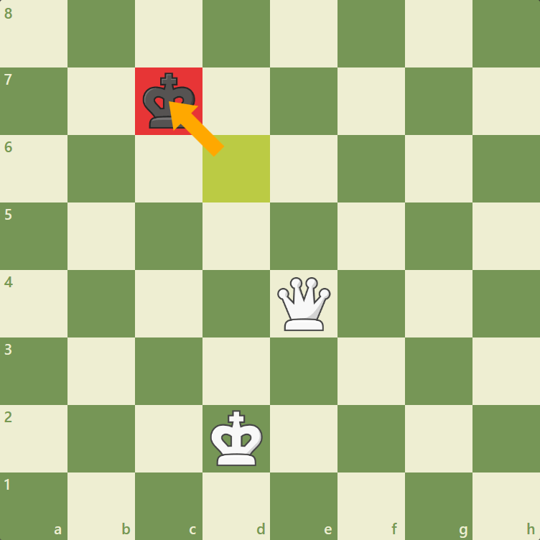
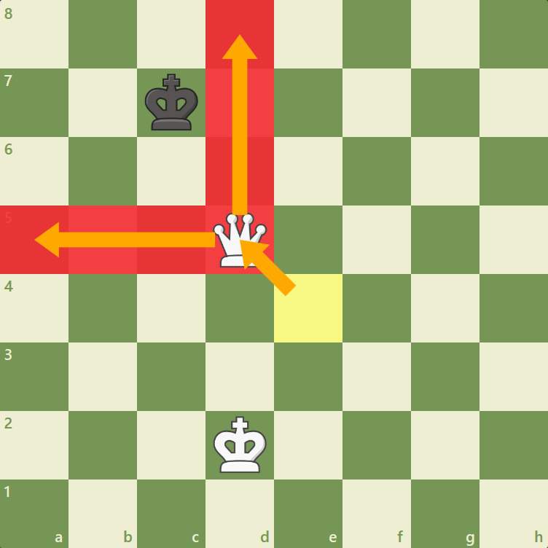
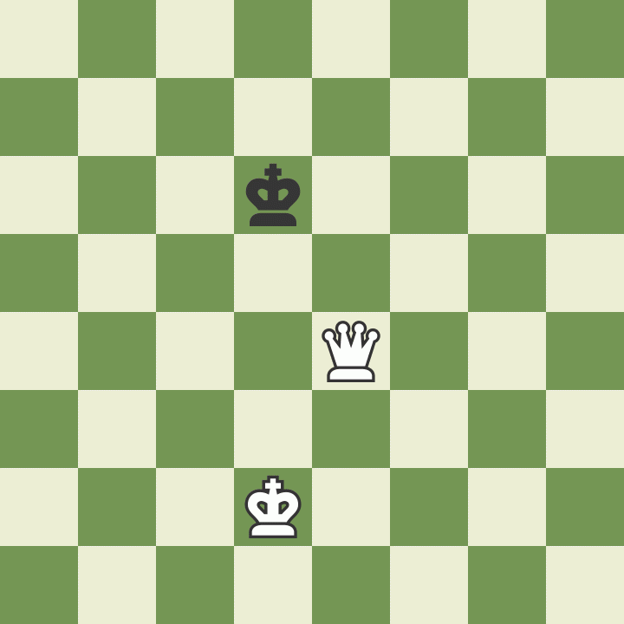
Dance With The King!
In this step, we literally copy the moves of the opponent's king with our queen. Whatever their king does, our queen does and always maintains the knight-move distance away from the enemy king. Once the King reaches the corner, STOP!

Slide 48
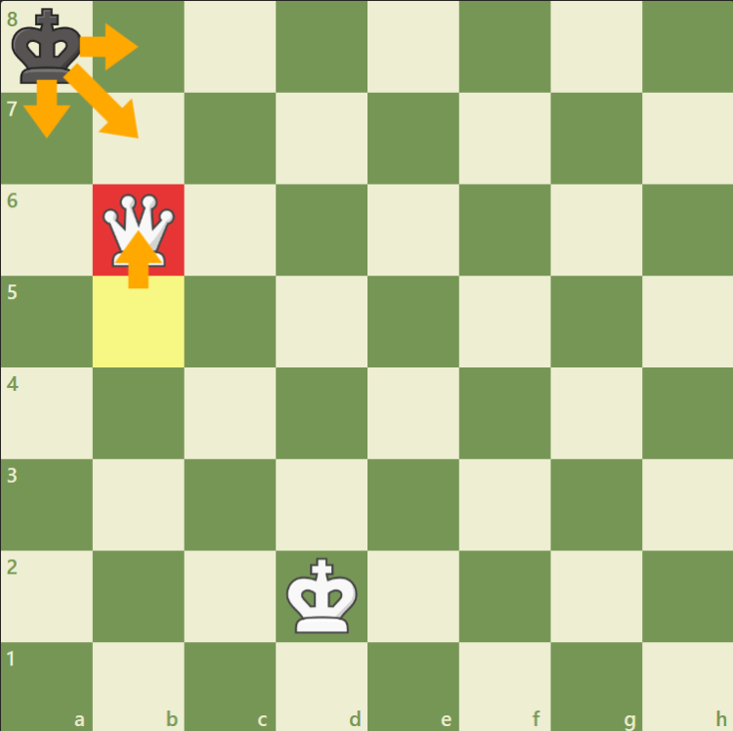
Freeze the Queen!
We must freeze the queen once the opponent's king reaches the corner!
You may be wondering why we must stop moving our queen once the enemy king reaches the corner. Well, take a look at what happens:
Stalemate! Our opponent has no legal moves (since a king can never move into check), and the game is a draw.

Slide 49
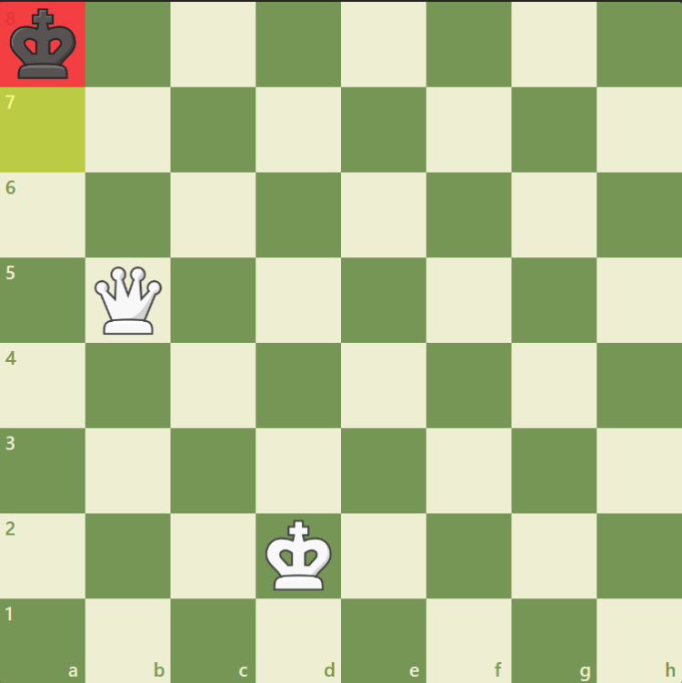
Freeze the Queen!
By freezing the queen after the enemy king reaches the corner, we can now see that Black's king is in a tiny box where it can only move two squares.
This means that it is time for step four: Walking the king over to deliver checkmate.

Slide 50
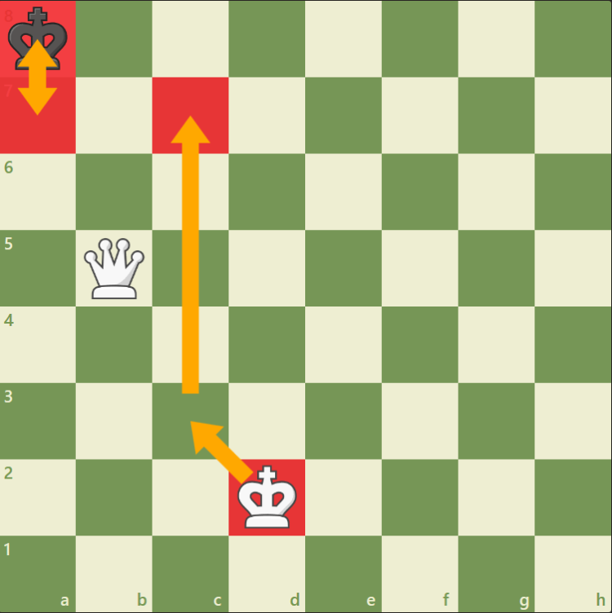
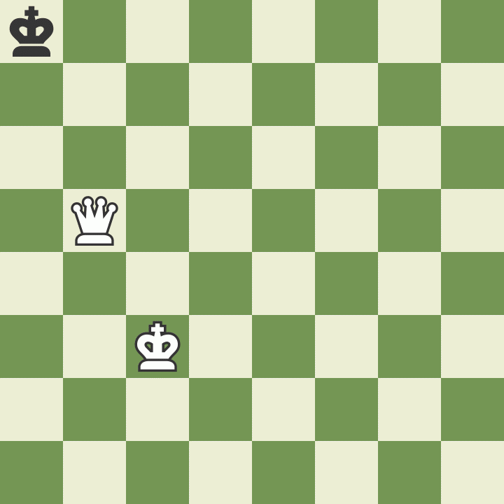
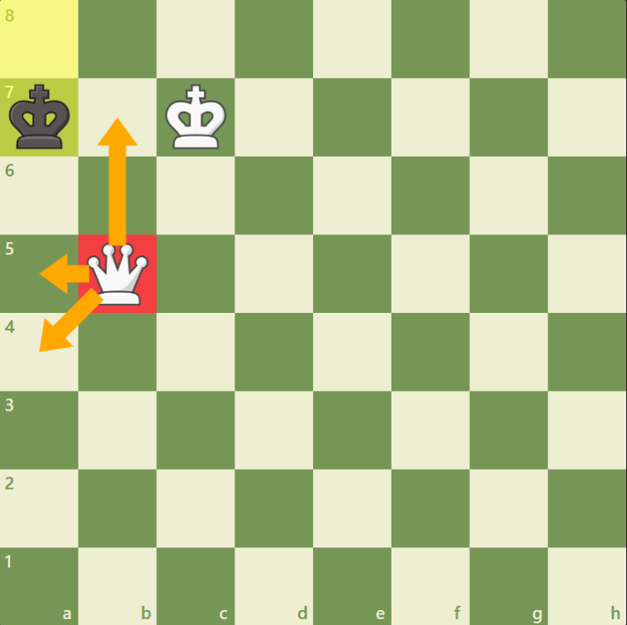
Walk The King Over To Deliver Checkmate
Now that the enemy king is in a box, we bring our king over to help deliver checkmate. Note that the black king can only move to two squares, like a prisoner in a jail cell.

Slide 51
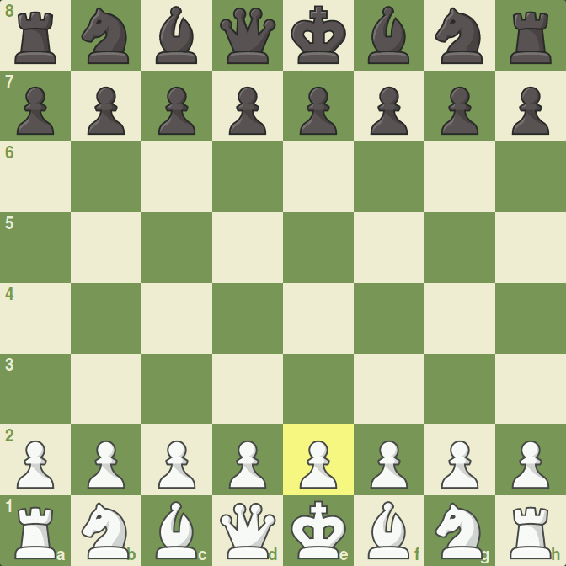
Scholar’s Mate
Scholar’s mate can be a really quick way of finishing a chess game.
The idea is to target the f7 pawn with your bishop and queen. Then, deliver checkmate with the queen on the next move if it is safe to plant the queen on f7.

Slide 52
Review Time
Now it’s time to practice our king and queen strategies on the chess board.
Remember how kings and queens move.
Try opening using the scholar’s mate strategy, you could win a 4 move game!

Slide 53
CLOSING CIRCLE
Share:
“What did you enjoy most today?”
“What is still confusing or unclear?”
Ninja Shout Outs:
“How did someone help you today?”
Notes:
CLOSING CIRCLE (10 min) Everyone should pitch in to clean and organize the center.
Gather ninjas in a circle, preferably away from the computer work area. Make sure that the conversation is inclusive, and many ninjas have a chance to share.

Slide 54
Week 4:
Today we will...
learn how to use the knight and rook
learn how to castle correctly and when you can castle
discuss checkmate patterns involving rook and knight

Slide 55
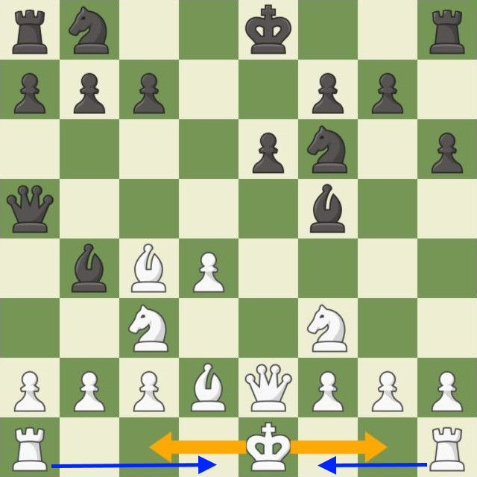
What is Castling and how to do it?
Castling is a move in chess where your king’s first move is to move two squares to its right or left and the rook hops over next to the king.
There are two ways to castle your king (kingside and queenside).
Castling is the only move in chess in which two pieces are moved at once.

Slide 56
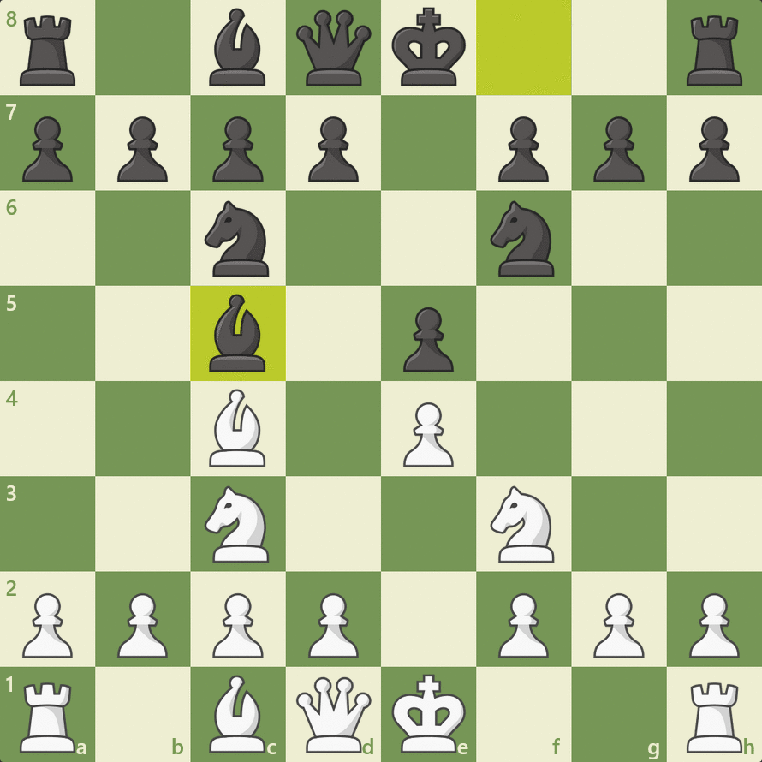
When can you castle?
You can castle if …
Neither the king nor the rook has previously moved
The squares between the king and the rook are vacant
The king does not leave, cross over, or finish on a square attacked by an enemy piece
***For example, if the f2 pawn was not there after the bishop moved to c5, then white cannot castle.***

Slide 57
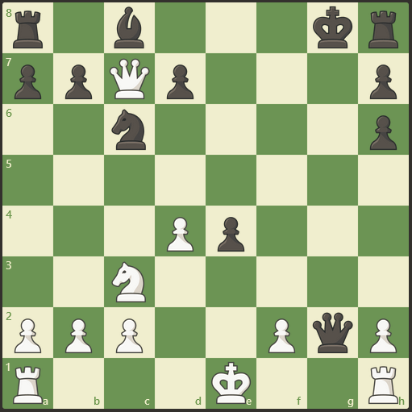
Can White Castle Here?
White cannot castle short on the kingside because the queen is attacking the f1 and g1 squares preventing the king to castle there.
However, White can castle long on the queenside because no pieces are between the queen’s rook and the king, no piece is attacking the c1 and d1 squares the king is moving through, and both the king and rook has not moved before castling.

Slide 58
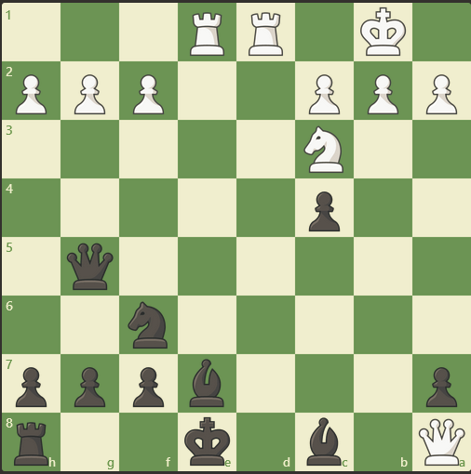
Can Black Castle Here?
Now, what if it was white’s turn to move?
If White moves his queen to c8, White has checkmate with the king in the back rank.

Slide 59
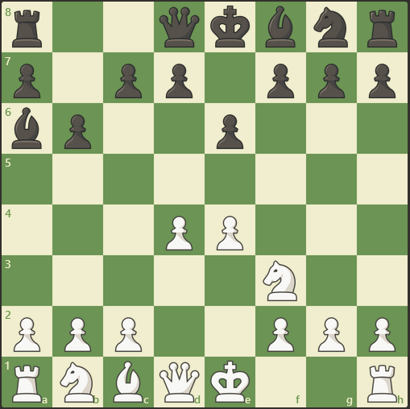
Can White Castle Here?
White cannot castle because the bishop on a6 is attacking the f1 square the White king is trying to castle through.

Slide 60
Checkmate Patterns with Rooks and Knights

Slide 61
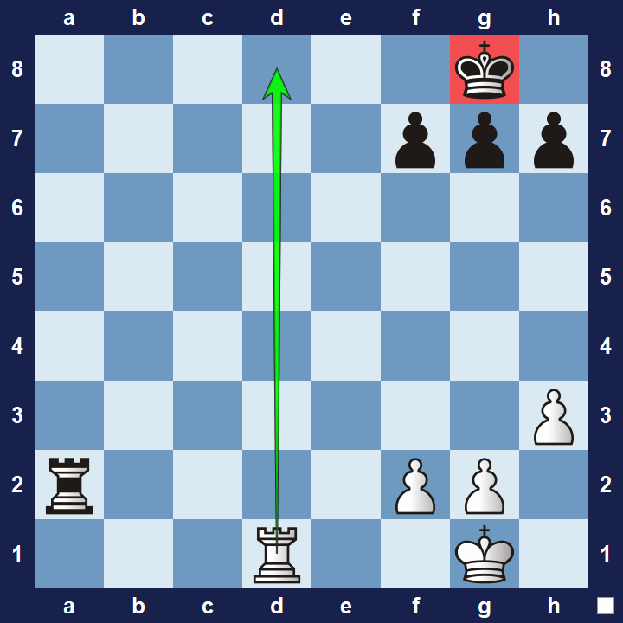
Back-rank Checkmate
The rook can deliver checkmate when the king is trapped by its own pawns on the second or 7th row (rank).
An easy for black to avoid this checkmate threat is if it pushes one of the pawns in front of the king so that the king can have an escape square.

Slide 62
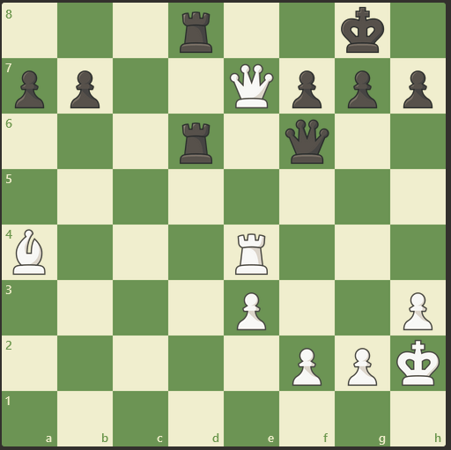
Let’s try a Puzzle
It is White’s Turn to move.
White has Mate in 2.

Slide 63
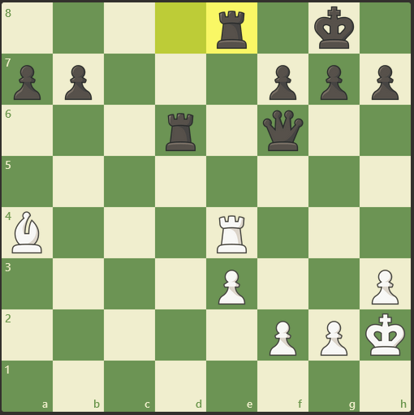
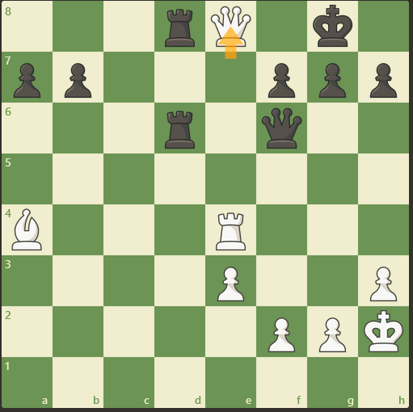

Solution

Slide 64

Let’s try a harder puzzle
It is White’s Turn to move.
Mate in 3 moves.

Slide 65

Solution

Slide 66

Arabian Mate
This checkmate pattern is set up where the rook is delivering checkmate with support of the knight protecting the square in front of the king.
Notice that the king cannot move and would be stalemate if it is black’s turn.
If it’s white’s turn, it will deliver checkmate by moving rook up front and personal to h7.

Slide 67

Let’s try a Puzzle
It is White’s Turn to move.
White has Mate in 1.

Slide 68

Solution

Slide 69

Let’s try a harder puzzle
It is Black’s turn to move.
Black has mate in 2 moves.

Slide 70

Solution

Slide 71

Smothered Mate
This checkmate pattern is set up where the knight delivers checkmate by checking the king trapped in the corner.
Notice that the king cannot move since it is smothered by its own pieces

Slide 72

Let’s try a Puzzle
It is Black’s Turn to move.
Black has Mate in 2.

Slide 73



Solution
Smothered Mate

Slide 74

Let’s try a harder puzzle
It is White’s Turn to move.
White has Mate in 3.

Slide 75

Solution

Slide 76
Review Time
Now it’s time to practice our knight and rook strategies on the chess board.
Remember how knights and rooks move.
Practice Castling and know how and when to do it
Try to incorporate some of the checkmate patterns you learn today into your chess games!

Slide 77
CLOSING CIRCLE
Share:
“What did you enjoy most today?”
“What is still confusing or unclear?”
Ninja Shout Outs:
“How did someone help you today?”
Notes:
CLOSING CIRCLE (10 min) Everyone should pitch in to clean and organize the center.
Gather ninjas in a circle, preferably away from the computer work area. Make sure that the conversation is inclusive, and many ninjas have a chance to share.

Slide 78
Week 5:
Today we will...
learn how to move and capture with our pieces and where they should go in the opening
know the values of chess pieces and how to make smart trades
try to avoid making bad trades

Slide 79

Opening principles
Chess Players by James Northcote (1746-1831)
Control the Center
Develop Your Pieces
Protect Your King
Activate Pieces
Consider Your opponent’s Move
Focusing on Phases of the Game

Slide 80


Control the Center
Put your pieces in the ideal position to control the most important part of the board - the center.
Control the center and you will control the game

Slide 81

Develop Your Pieces
Take control of the game by developing your pieces rapidly to squares where they control the center.
Blue Inner Center is called the chess mountain, these four squares are critical in controlling the center
Green Outer Center is called the chess hill these squares are not as high as the chess mountain but still important in controlling the center mountain

Slide 82



Develop Your Pieces
Let’s pretend for a moment we can only move two pawns and the rest of our pieces only once. What would that look like?

Slide 83


Protect Your King
Usually the best way to secure your king is to castle.
Castle early and castle often…
Remember, this is the only time you can move two pieces at once!!!
Here is an example of a great opening strategy, after 3 moves white’s fourth move can….?
You guessed it!
Build a house to protect your king!

Slide 84

Active Pieces
An active piece has the potential to make many moves. The best way to get pieces active is to move them towards the center of the board.
When you start a game of chess none of your pieces are active, most of your pieces can’t even move.
Your job is to get your pieces into the game and put them on active squares where they can attack, defend, and improve your position on the board.

Slide 85

Active Pieces
Can you identify who has the more active pieces?
That’s right it’s white!

Slide 86

Active Pieces
Can you identify who has the more active pieces?
That’s right it’s white!

Slide 87




Your opponent’s Move
It’s important to pay attention to what your opponent is trying to do each turn.
What’s a good defensive move in this position?

Slide 88
Phases of the Game
Chess games feature three phases:
Opening Phase:
Once you make first move on the chess board this is what’s called the opening phase
Middle Game Phase:
Once most pieces have developed the game enters the middle game phase
End Game Phase:
After many pieces have been traded away this is when we usually enter the end game phase

Slide 89



Opening Phase
This is where you begin to develop your pieces on good squares where they can attack defend and control the center. There are three main goals in the opening:
1. Establish control in the center
2. Get your pieces onto active squares
3. Get your king to safety by castling

Slide 90

Middle Game Phase
This is where both players are making plans, organizing their pieces and attacking the opponent’s king
Some games end in the middle phase
For example white creates a battery from the b1-h7 diagonal threatening checkmate and the unprotected rook on a8

Slide 91



End Game Phase
The goal is usually to promote a pawn to a queen and then checkmate your opponent

Slide 92

Chess Piece Values
Each piece has a different value
The piece values are directly tied to a piece's strength
The king is the only piece that doesn't have a point value, this is because the king cannot be captured
Simple math can help us determine what exchanges we should pursue and which exchanges we should avoid

Slide 93

Practice Problem
In the following position, Black has just played Rh6. Should White capture the rook on h6 with their dark-squared bishop on c1?
Yes! White should capture the rook on h6 with the bishop on c1 because the rook is worth five points while the bishop is worth 3 points.

Slide 94


Practice Problem
Should the White queen capture the rook on the e8-square?
Yes, White should capture the rook on e8! The point is that White is getting two rooks for the queen (ten points for nine points), but more importantly because Black's king is in great danger and checkmate will soon follow on the eighth rank

Slide 95
Review Time
We now know what chess piece values mean and what each of their relative values are.
We learned the three phases of the game.
Now it’s time for us to practice controlling the center and developing your pieces onto the board.
Try incorporating some of the opening principles you learned today into your chess games!
Remember to always protect your king! (castle)

Slide 96
CLOSING CIRCLE
Share:
“What did you enjoy most today?”
“What is still confusing or unclear?”
Ninja Shout Outs:
“How did someone help you today?”
Notes:
CLOSING CIRCLE (10 min) Everyone should pitch in to clean and organize the center.
Gather ninjas in a circle, preferably away from the computer work area. Make sure that the conversation is inclusive, and many ninjas have a chance to share.

Slide 97
Week 6:
Today we will...
learn some basic tactics such as forks, pins, and discovered attacks
learn an essential checkmate pattern called ladder mate
practice with some checkmate exercises

Slide 98

Forks
A fork is a basic chess tactic that consists of a single piece attacking two or more pieces at the same time. The attacking piece is known as the forking piece, while the attacked troops are known as the forked pieces.

Slide 99

Exercise
It is black’s turn to move. What is the best move in this position?

Slide 100

Solution

Slide 101

Pins
A pin is a tactic you can use to restrict one or more of your opponent's pieces. You can do it by attacking the other player's forces in a way that allows you to explore a much greater vulnerability if the attacked piece moves. Usually, the pinned piece blocks an attack to a more valuable piece, but it could also protect a key defender of the position or even impede a checkmate.

Slide 102

Exercise
It is white’s turn to move. What is the best move in this position?

Slide 103

Solution

Slide 104

Discovered Attacks
A discovered attack happens when a player moves one piece out of the way to reveal a previously blocked attack by another piece.
A discovered attack is a dangerous tactic that you can use to surprise your opponent and win the game.

Slide 105

Exercise
It is black’s turn to move. What is the best move in this position?

Slide 106

Solution

Slide 107

Ladder Mate
Ladder Mate is a common checkmate pattern which can be done using 2 rooks, 1 rook and 1 queen, or 2 queens.
This checkmate pattern works by forcing the king to move to the edge of the board where the remaining piece traps the king on two files (columns) or ranks (rows).
This is one of the most common (and easiest) checkmate patterns to do.

Slide 108

How to Ladder Mate?
The first step is to cut the king off by one rank or file.

Slide 109


How to Ladder Mate?

Slide 110
How to Ladder Mate?
Then, alternate with the other rook/queen to force the king to move closer towards the edge of the chess board.

Slide 111


How to Ladder Mate?

Slide 112
How to Ladder Mate?
Repeat until the king is at the edge of the board and deliver checkmate!

Slide 113


How to Ladder Mate?

Slide 114

How to Ladder Mate?

Slide 115
Time for Checkmate Puzzles

Slide 116

It is White’s Turn to move.
White has Mate in 1.

Slide 117

Solution

Slide 118
Any of these moves is checkmate!!!

Slide 119

It is White’s Turn to move.
White has Mate in 1.

Slide 120

Solution

Slide 121

It is White’s Turn to move.
White has Mate in 2.
What should Black’s first move be?

Slide 122

Solution Part 1

Slide 123

White moves Rook to f2 capturing the queen.
What should Black’s next move be?

Slide 124

Solution Part 2

Slide 125
Review Time
Recall the opening principles and the values of all the chess pieces from last week.
Remember how all the pieces move and how to coordinate them.
Try incorporating some of the tactics you learned today into your chess games!
Remember how to do ladder mate as it is the easiest checkmate pattern to do!

Slide 126
CLOSING CIRCLE
Share:
“What did you enjoy most today?”
“What is still confusing or unclear?”
Ninja Shout Outs:
“How did someone help you today?”
Notes:
CLOSING CIRCLE (10 min) Everyone should pitch in to clean and organize the center.
Gather ninjas in a circle, preferably away from the computer work area. Make sure that the conversation is inclusive, and many ninjas have a chance to share.

Slide 127
Week 7:
Today we will...
Beginner level chess openings
learn how to come back from a losing position
A new move?!?!?! Waaaaaa?!

Slide 128
Lets jump right in!

Slide 129

The French Defense
The French Defense is one of the first strategic openings every chess player should learn. After e5 (now or later), both sides will have pawn chains. One risk of the French Defense is that the c8-bishop can be very hard to develop.

Slide 130
The Italian Game
The point is to control the center quickly with your pawn and knight and then put your bishop on its most dangerous square. You are also preparing to castle to safety.

Slide 131

The Sicilian Defense
The Sicilian Defense is the most popular choice of aggressive players with the black pieces. Often White will play 2.Nf3 and 3.d4 which will gain central space, but it allows Black to benefit by exchanging a central pawn for a bishop's pawn.

Slide 132
The Ruy-Lopez
The Ruy Lopez is one of the oldest and most classic of all openings. It is named after a Spanish bishop who wrote one of the first books on chess. The Ruy Lopez attacks the knight which defends the e5-pawn. White hopes to use this attack to build more pressure on Black's central pawn.

Slide 133

The Slav Defense
The Slav Defense is a very solid opening which defends the d5-pawn with another pawn. Most of Black's pieces can develop to natural squares, but Black will usually have a little less space and will have to find a good place for their b8-knight.

Slide 134
How to draw in chess
There are 4 ways to draw in chess.
Stalemate
Dead Position
Mutual Agreement (Both Players Agree to a draw)
Threefold Repetition

Slide 135

Stalemate
It happens when the player who has to move has no legal moves available

Slide 136

Dead Position
A dead position happens when neither player can legally checkmate the opponent's king. If the game reaches this situation and the move that generated the position is legal, the game ends in a tie.

Slide 137

Threefold Repetition
The threefold repetition rule states that if a game reaches the same position three times, a draw can be claimed. A position is repeated if all pieces of the same kind and color are on identical squares, and all possible moves are the same.

Slide 138
Review Time
Try to start your games with some of the beginner openings we learned today.
Recap what are the values of all the chess pieces.
Remember how all the pieces move and how to coordinate them.
Recall how to draw in chess.

Slide 139
But Wait…

Slide 140
There is one more special move in chess to uncover!

Slide 141

En Passant
En Passant is a move in chess where a pawn can capture another pawn when it has moved two squares from its starting rank.
There are a few requirements for the move to be legal:
The pawn must have moved two squares in one move landing right next to the capturing pawn.
The capture must happen immediately after the pawn has moved two squares.
If the player does not do en passant that turn, then they can no longer do it later.

Slide 142
CLOSING CIRCLE
Share:
“What did you enjoy most today?”
“What is still confusing or unclear?”
Ninja Shout Outs:
“How did someone help you today?”
Notes:
CLOSING CIRCLE (10 min) Everyone should pitch in to clean and organize the center.
Gather ninjas in a circle, preferably away from the computer work area. Make sure that the conversation is inclusive, and many ninjas have a chance to share.

Slide 143
Chess Tournament Next Class!!!!!!!!!!
Prepare everything we’ve taught you and bring your A-game to compete for a chance to win a some epic chess piece prizes!

Slide 144
Week 8:
Today we will...
Hone our skills
Compete in the chess tournament…

Slide 145
Chess Tournament
Division #1
Division #2
Division #3
Angie Zheng
Lincoln Le
Christopher To
Alexander Le
Marsel Urmanov
Milo Zermeno
Olivia O’Brien
Anthony Cabana
Christian Buyson
John Edmond
Soyeon Kim

Slide 146
Division #1
 | WINNER (+1) | LOSER (+0) | ISDRAW? (+0.5) | Total
Angie Zheng vs Lincoln Le |  |  |  | Angie (0) Lincoln (0)
Lincoln Le vs Christopher To |  |  |  | Lincoln (0) Christopher (0)
Christopher To vs Angie Zheng |  |  |  | Christopher (0) Angie (0)
Players | Total Points
Angie Zheng | 0
Lincoln Le | 0
Christopher To | 0

Slide 147

Division #2
Olivia O’Brien
Marsel Urmanov
Alexander Le
Milo Zermeno

Slide 148
Division #3
Anthony Cabana
Soyeon Kim
Soyeon Kim
Christian Buyson
Christian Buyson
John Edmond

Slide 149
CLOSING CIRCLE
Share:
“What did you enjoy most today?”
“What is still confusing or unclear?”
Ninja Shout Outs:
“How did someone help you today?”
Notes:
CLOSING CIRCLE (10 min) Everyone should pitch in to clean and organize the center.
Gather ninjas in a circle, preferably away from the computer work area. Make sure that the conversation is inclusive, and many ninjas have a chance to share.

